Slide 1
GAN for image compression
ECE 285: Video and Image Compression
Presenter: You-Yi Jau, M.S. in UCSD

Slide 2
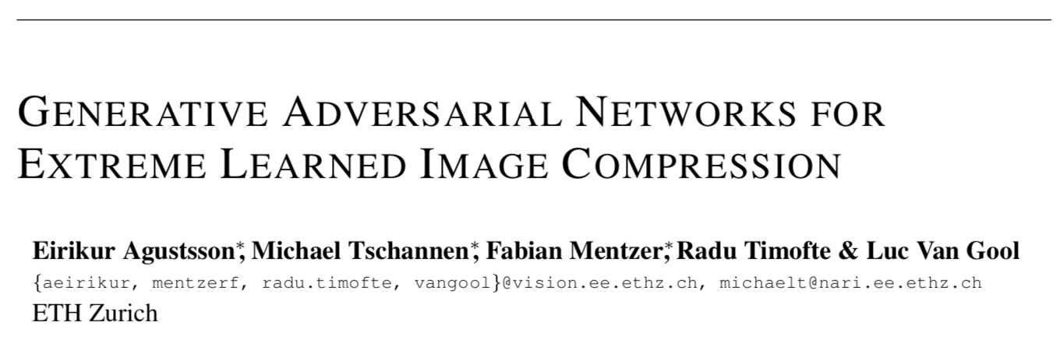
CVPR 2018
Generative adversarial networks for extreme learned image compression
E Agustsson, M Tschannen, F Mentzer, R Timofte… - arXiv preprint arXiv …, 2018
Notes:
Luc Van Gool: Speeded-up robust features (SURF)

Slide 3
Outlines
Motivation
Related works
Method overview
Method details
Experiments
Discussion

Slide 4
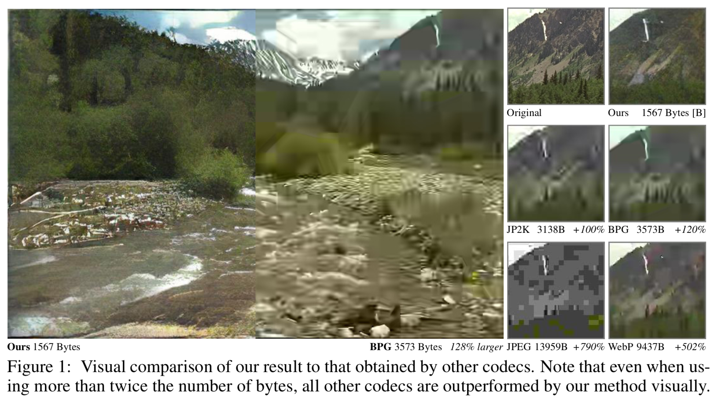
Compressed images

Slide 5
Motivation and problem description
How to compress images?
Deep compression systems works competitive with engineered codecs
WebP, JPEG2000, BPG (State-of-the-art)
Previous deep compression systems are optimized for traditional distortion metrics
peak signal-to-noise ratio (PSNR), multi-scale structural similarity (MS-SSIM)
How to achieve very low bitrates (below 0.1 bits per pixel (bpp))?
Problem description
Input: image
Compressed Codes: hidden layer
Output: Compressed image
Notes:
such as peak signal-to-noise ratio (PSNR) or multi-scale structural similarity (MS-SSIM)

Slide 6
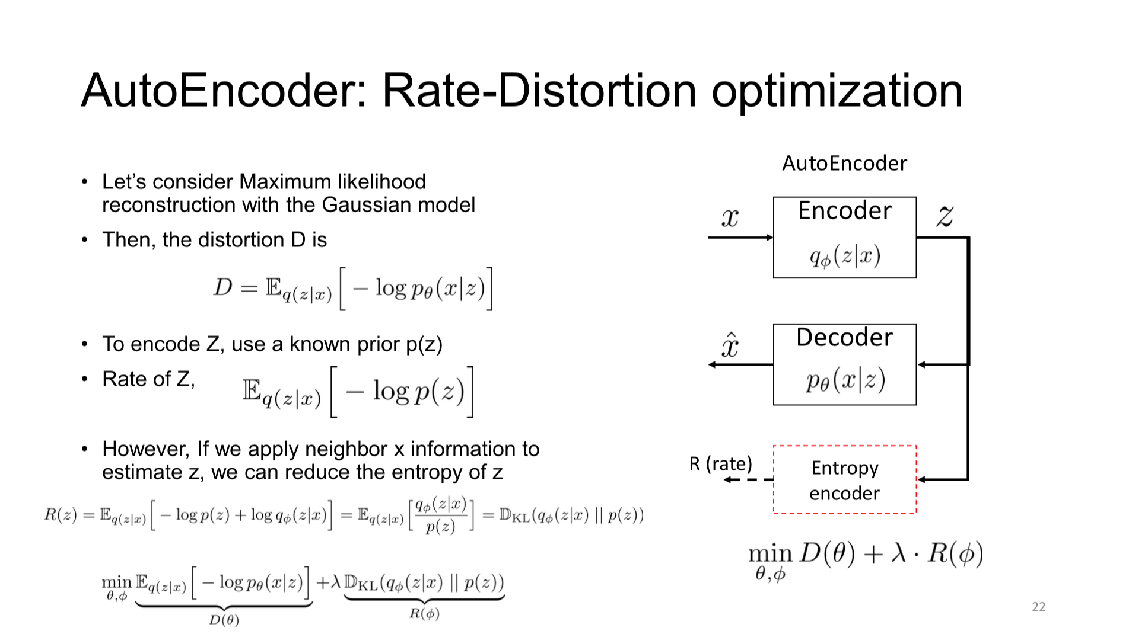
UCSD ECE 285: Image and video compression.

Slide 7
Related works
Traditional methods
WebP
JPEG2000
BPG (Better Portable Graphics)
the state-of-the-art engineered codec
Created by Fabrice Bellard in 2014
Deep methods
Auto-encoder
Variational Auto-encoder (VAE)
Recurrent neural network (RNN)
Generative Adversarial Network (GAN)
Hung-yi Lee - MLDS18 (Chinese)

Slide 8
Deep learning methods in recent years
Conditional probability models for deep image compression
F Mentzer, E Agustsson, M Tschannen, R Timofte… - Proceedings of the IEEE …, 2018
Full resolution image compression with recurrent neural networks
G Toderici, D Vincent, N Johnston, S Jin Hwang… - Proceedings of the IEEE …, 2017
Lossy image compression with compressive autoencoders
L Theis, W Shi, A Cunningham, F Huszár - arXiv preprint arXiv:1703.00395, 2017
End-to-end optimized image compression
J Ballé, V Laparra, EP Simoncelli - arXiv preprint arXiv:1611.01704, 2016
Real-time adaptive image compression
O Rippel, L Bourdev - Proceedings of the 34th International Conference on …, 2017
Deep compression: Compressing deep neural networks with pruning, trained quantization and huffman coding
S Han, H Mao, WJ Dally - arXiv preprint arXiv:1510.00149, 2015
Generative adversarial networks for extreme learned image compression
E Agustsson, M Tschannen, F Mentzer, R Timofte… - arXiv preprint arXiv …, 2018

Slide 9
Related works
Generative Adversarial Network (GAN)
Hung-yi Lee - MLDS18 (Chinese)

Slide 10
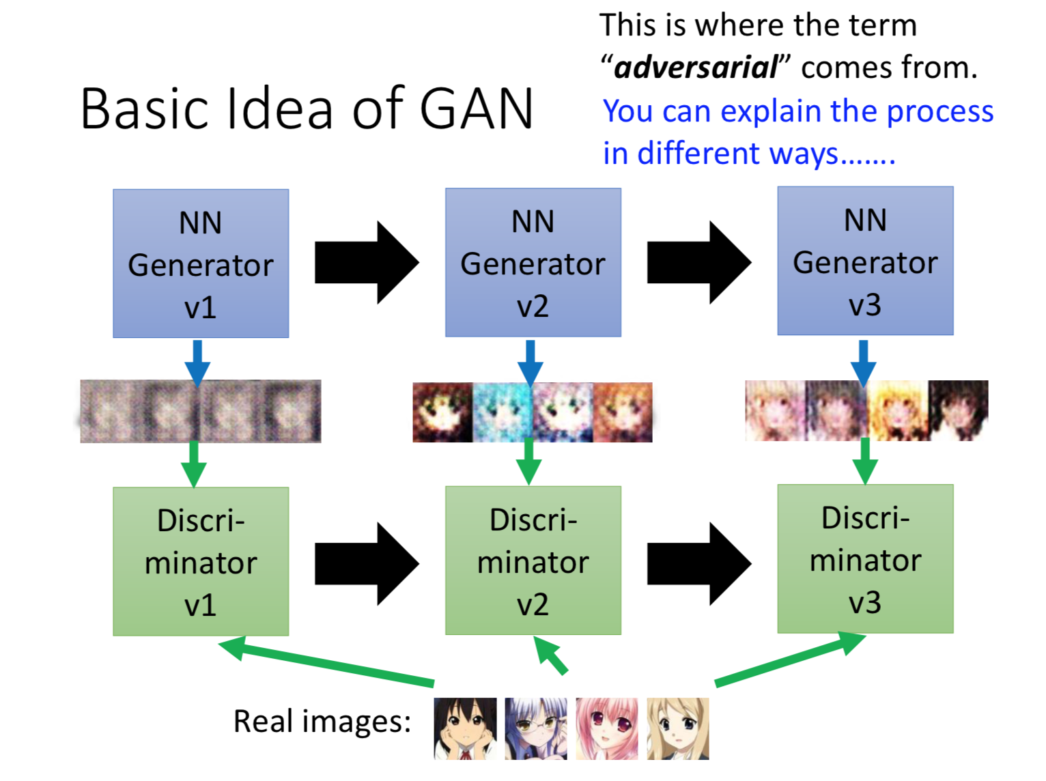
Hung-yi Lee - MLDS18 (Chinese)

Slide 11
Related works
Conditional Generative Adversarial Network (cGAN)

Slide 12
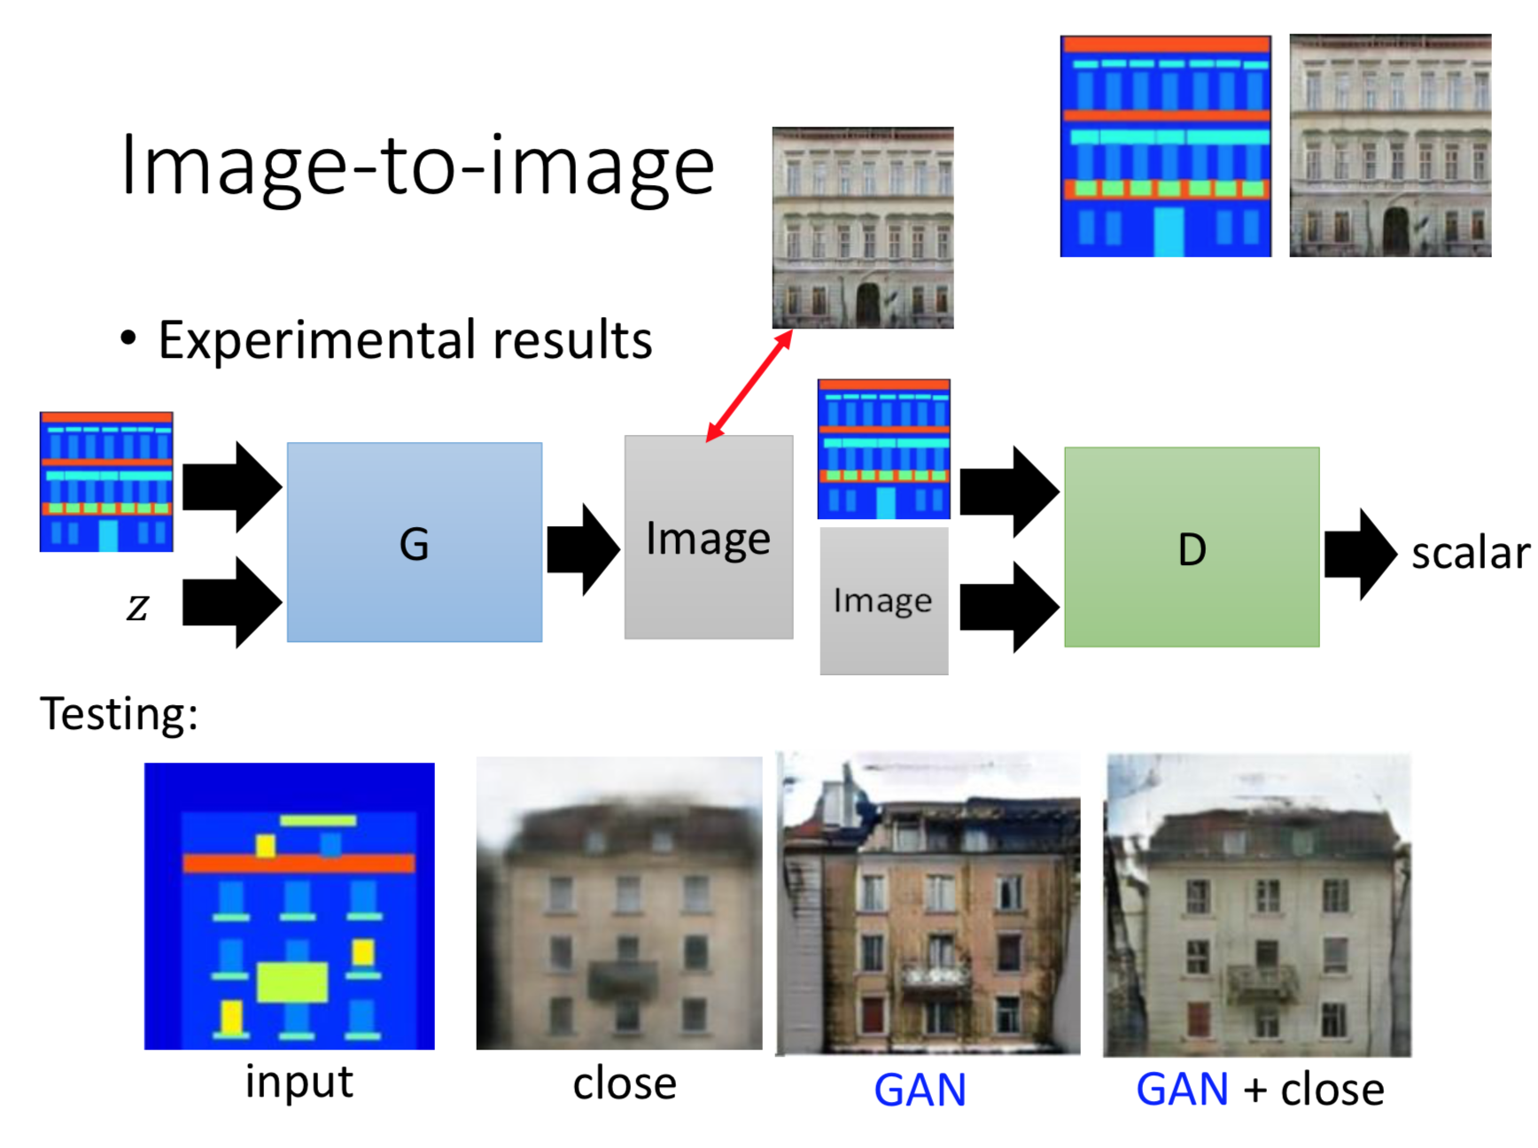
Hung-yi Lee - MLDS18 (Chinese)

Slide 13
Related works
Deep Image Compression
Reduce the entropy

Slide 14
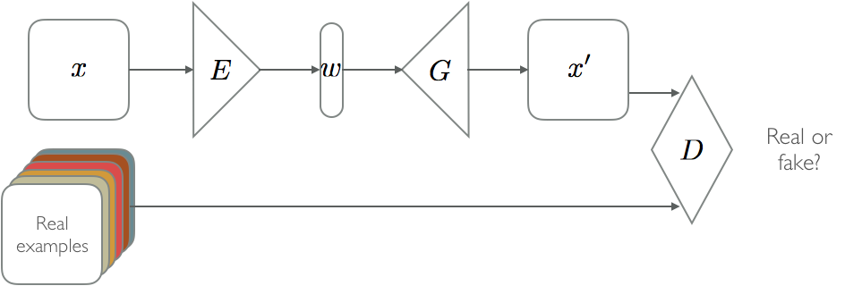
Method overview
Auto-encoder GANs
E: Encoder
G: Generator (Decoder)
D: Discriminator
x: image
w: code
SqueezedIn: Extreme image compression with Deep Learning by Michael Lomnitz

Slide 15
Two types of compression
Generative compression (GC)
preserving the overall image content
Selective generative compression (SC)
completely generating parts of the image from a semantic label map
preserving user-defined regions with a high degree of detail

Slide 16
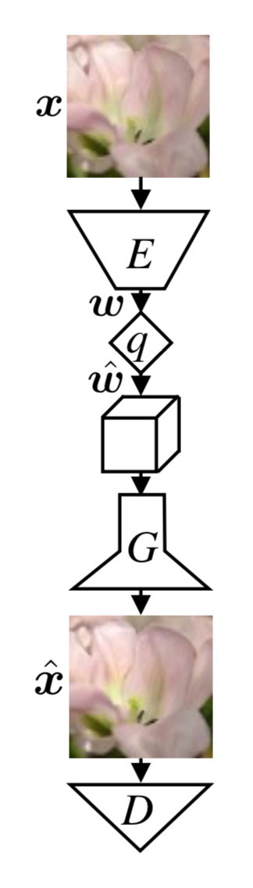
Generative compression (GC)
Encoder
Quantization
Generator
Discriminator
Soft-to-hard vector quantization for end-to-end learning compressible representations
E Agustsson, F Mentzer, M Tschannen, L Cavigelli… - Advances in Neural …, 2017

Slide 17
Model detail and analysis
Objective function
GAN
cGAN

Slide 18
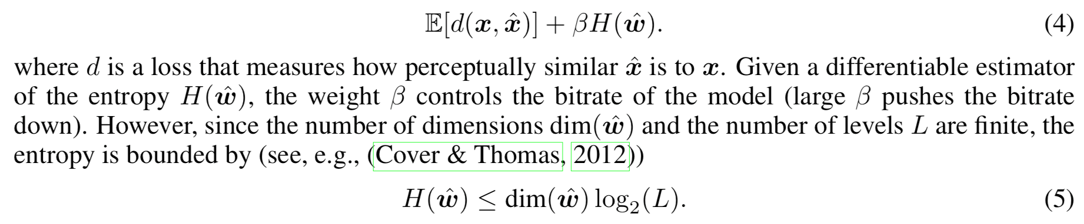
Model detail and analysis
Objective function
Image compression: entropy

Slide 19
Model detail and analysis
cGAN
Image compression: entropy
Objective function

Slide 20
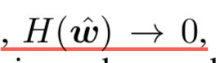
Selection of beta
Beta → infinity
pushes the bitrate down
Beta → 0
Becomes original GAN
suboptimal bitrates

Slide 21
Method overview
Auto-encoder GANs
E: Encoder
G: Generator (Decoder)
D: Discriminator
x: image
w: code
SqueezedIn: Extreme image compression with Deep Learning by Michael Lomnitz

Slide 22
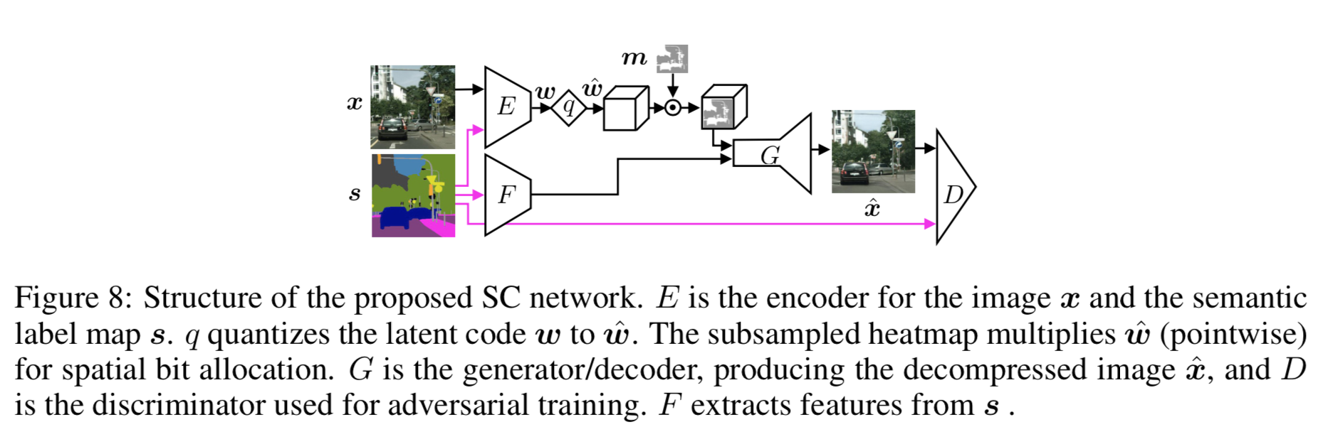
Selective generative compression (SC)

Slide 23
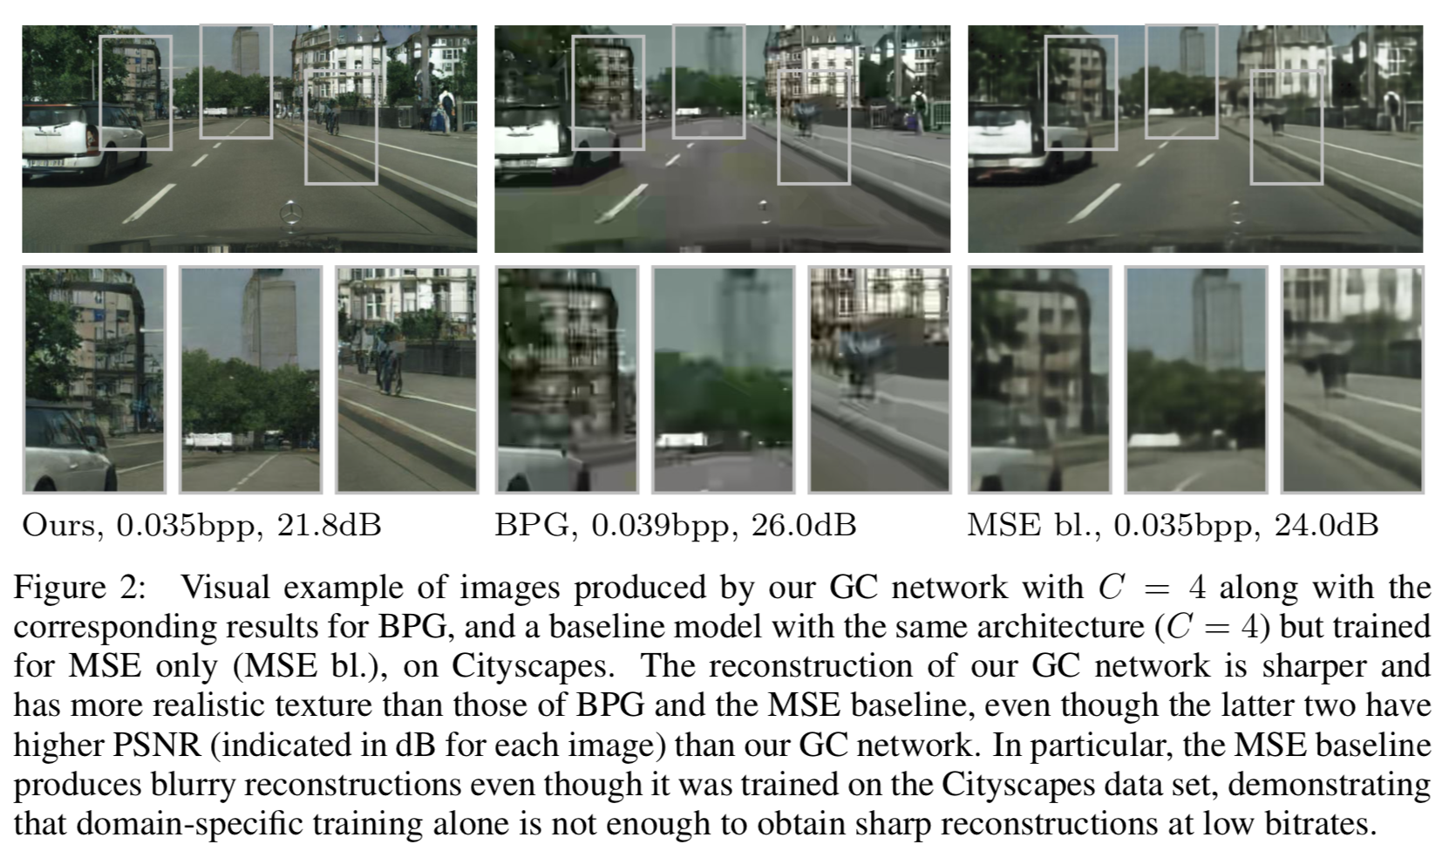
Experiments
Notes:
PSNR is not useful.

Slide 24
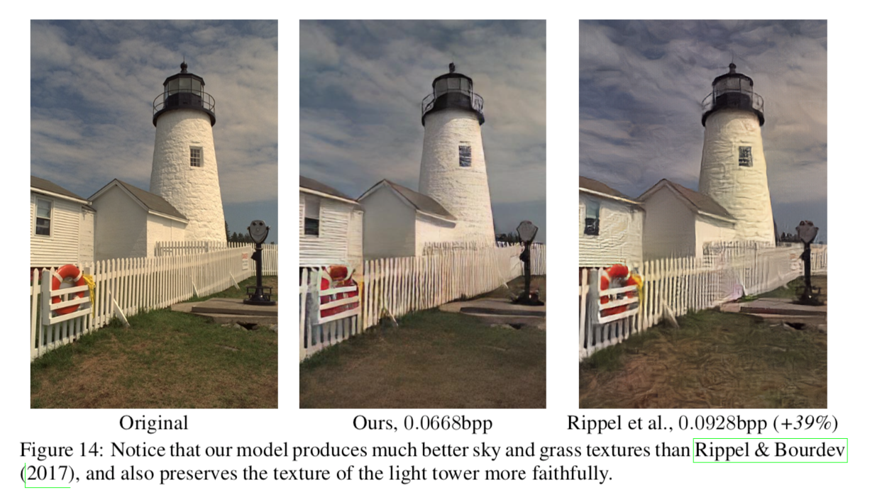
Compare with prior work
Oren Rippel and Lubomir Bourdev. Real-time adaptive image compression. In Proceedings of the 34th International Conference on Machine Learning, volume 70 of Proceedings of Machine Learning Research, pp. 2922–2930, International Convention Centre, Sydney, Australia, 06–11 Aug 2017. PMLR.

Slide 25
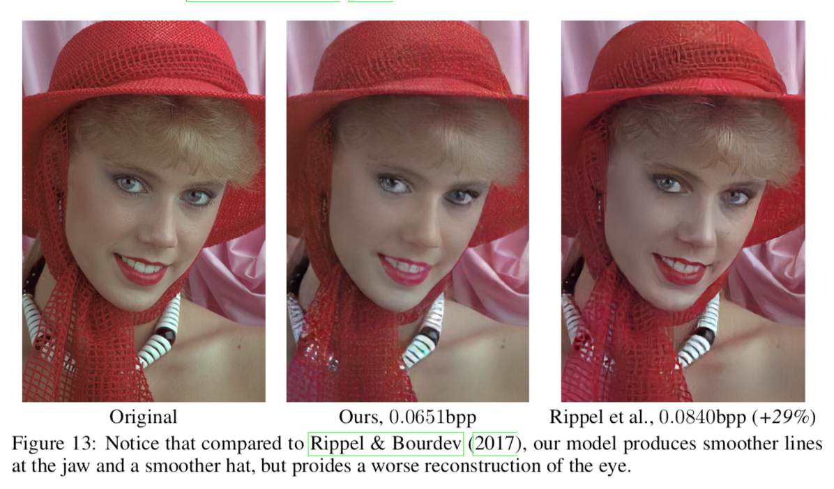
Compare with prior work
Oren Rippel and Lubomir Bourdev. Real-time adaptive image compression. In Proceedings of the 34th International Conference on Machine Learning, volume 70 of Proceedings of Machine Learning Research, pp. 2922–2930, International Convention Centre, Sydney, Australia, 06–11 Aug 2017. PMLR.

Slide 26
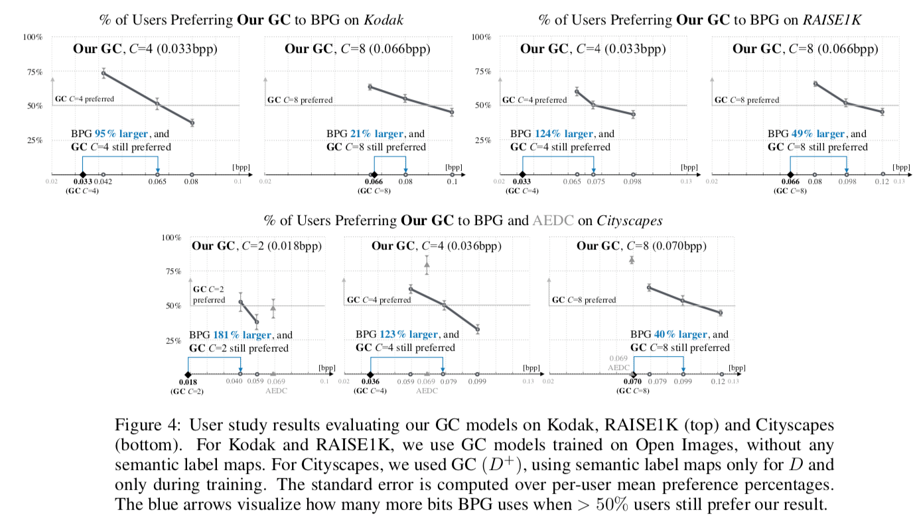
User study

Slide 27
Discussion
What are the tricks?
The model saves information
Number of variables: 16M
Total bytes: 651 MB
checkpoint size: >2.5 GB

Slide 28
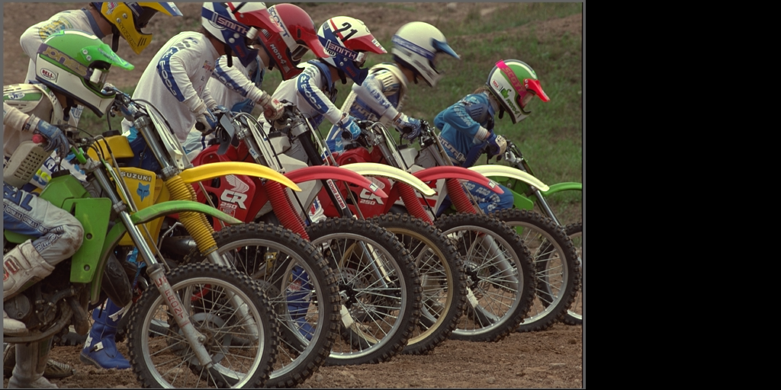
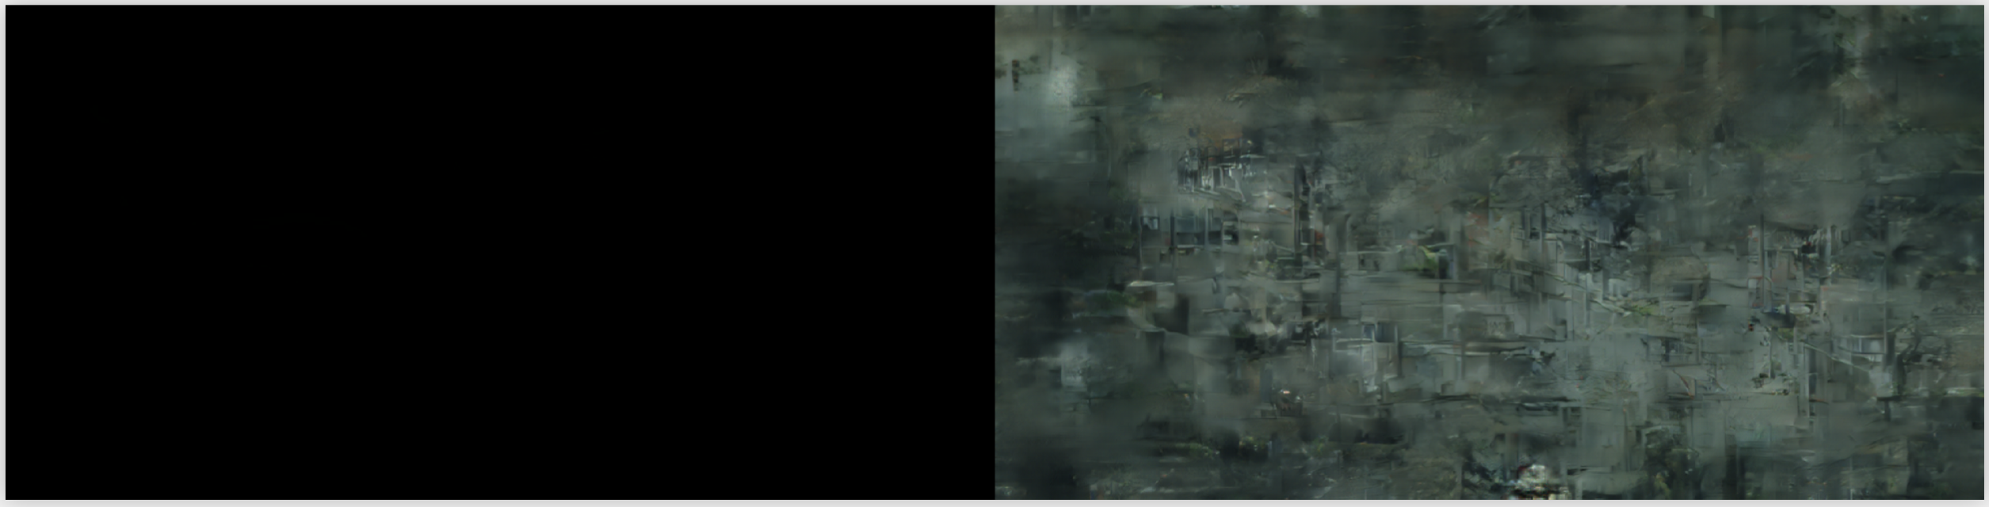
Discussion
How to run the code?
Download image
Resize to [512, 1024]
Feed in to the model
eric-yyjau/generative-compression: TensorFlow Implementation of Generative Adversarial Networks for Extreme Learned Image Compression

Slide 29
Discussion
Is the comparison fair?
 | Traditional method | Deep method
Method | BPG | GAN
Time complexity | Fast | 5s/iteration
bpp |  | <0.1bbp
Overhead | Small (similar to JPEG) | Model weights: Large
Notes:
Better Portable Graphics (BPG) is a file format for coding digital images, which was created by programmer Fabrice Bellard in 2014. He has proposed it as a replacement for the JPEG image format as the more compression-efficient alternative in terms of image quality or file size.^{[1]}
It is based on the intra-frame encoding of the High Efficiency Video Coding (HEVC) video compression standard.^{[2]} Tests on photographic images in July 2014 found that BPG produced smaller files for a given quality than JPEG, JPEG XR and WebP.^{[3]}
BPG vs JPEG: Everything You Need to Know
BPG Image format

Slide 30
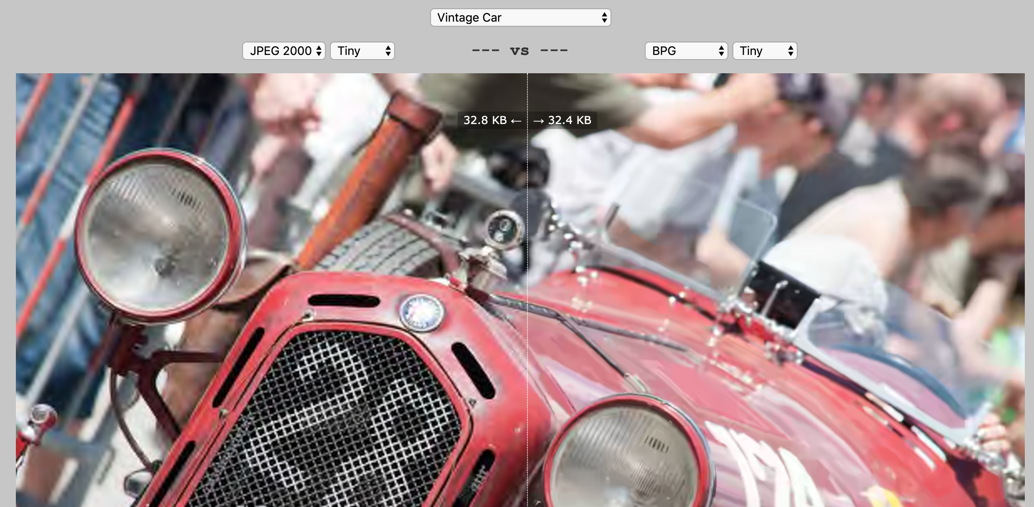
Traditional method
BPG Image Comparison

Slide 31
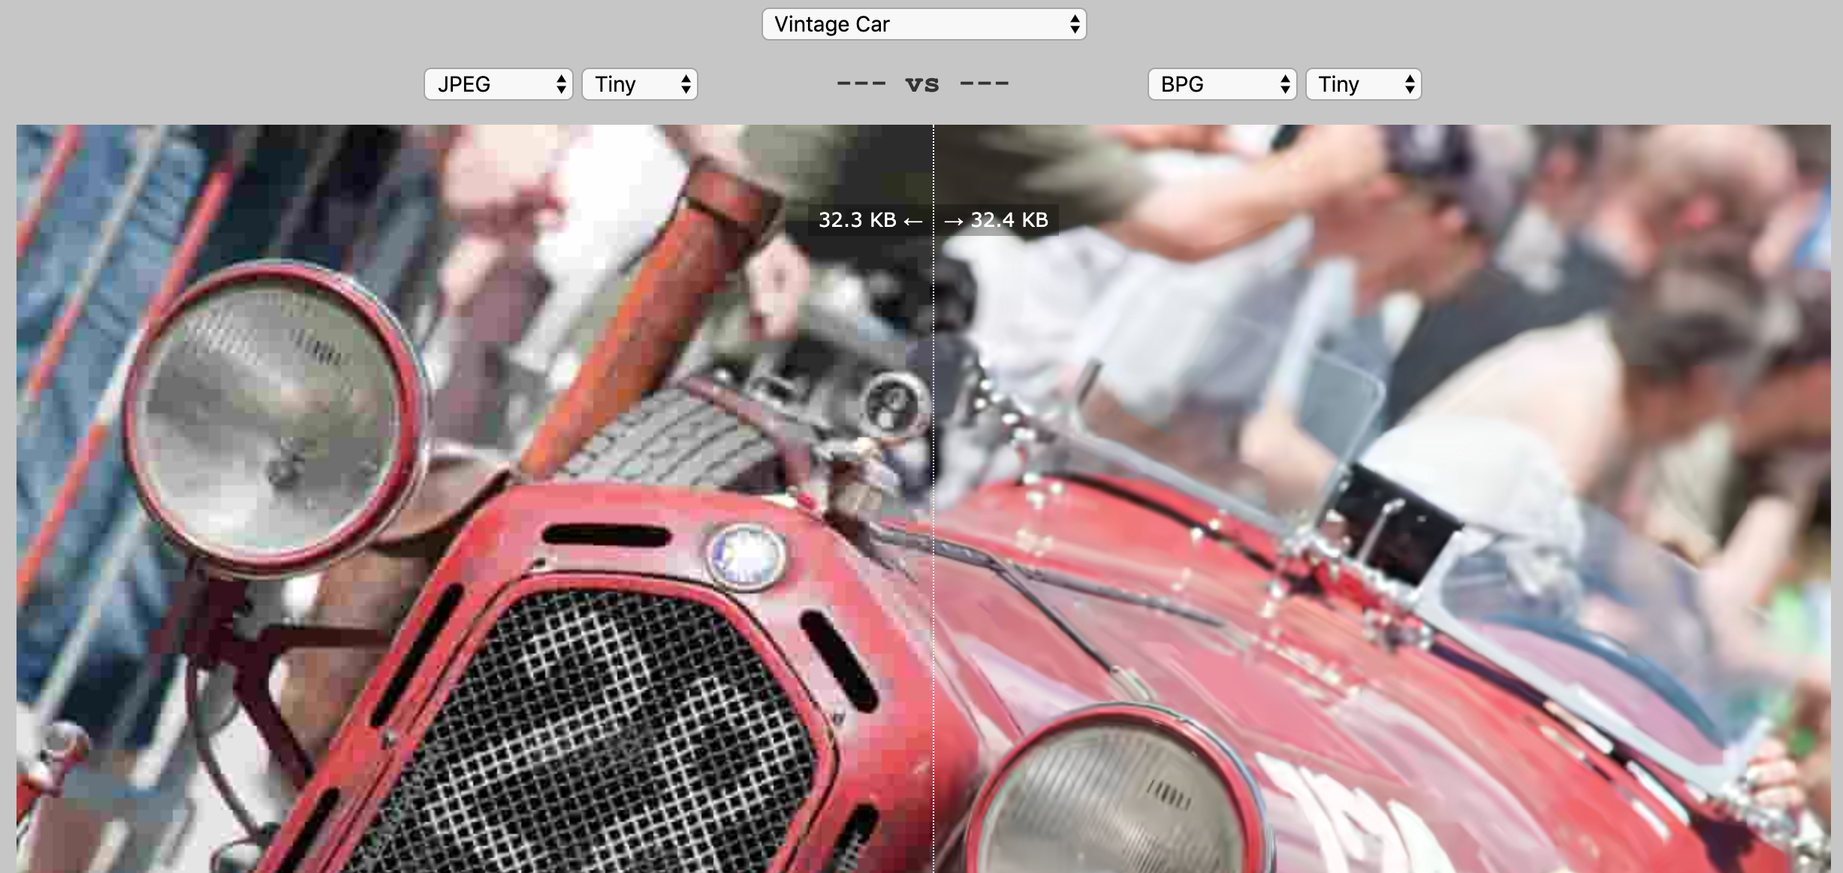
Traditional method

Slide 32
Discussion
Is the work practical?

Slide 33
Future work
Deep learning method requires to store model weights
Recover an image takes up to seconds
Light-weighted models?

Slide 34
Questions?

Slide 35
Thank you

Slide 36
Backup

Slide 37
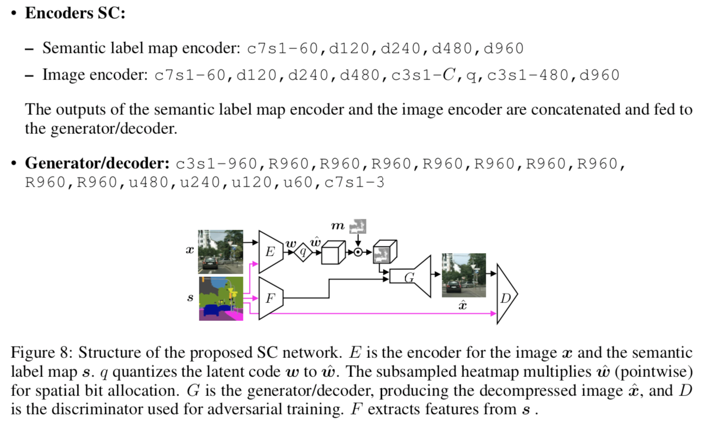

Slide 38
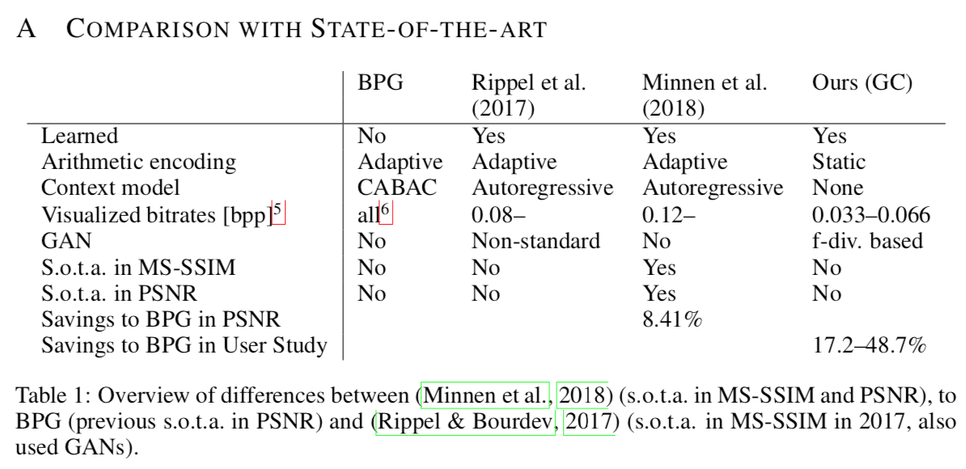

Slide 39
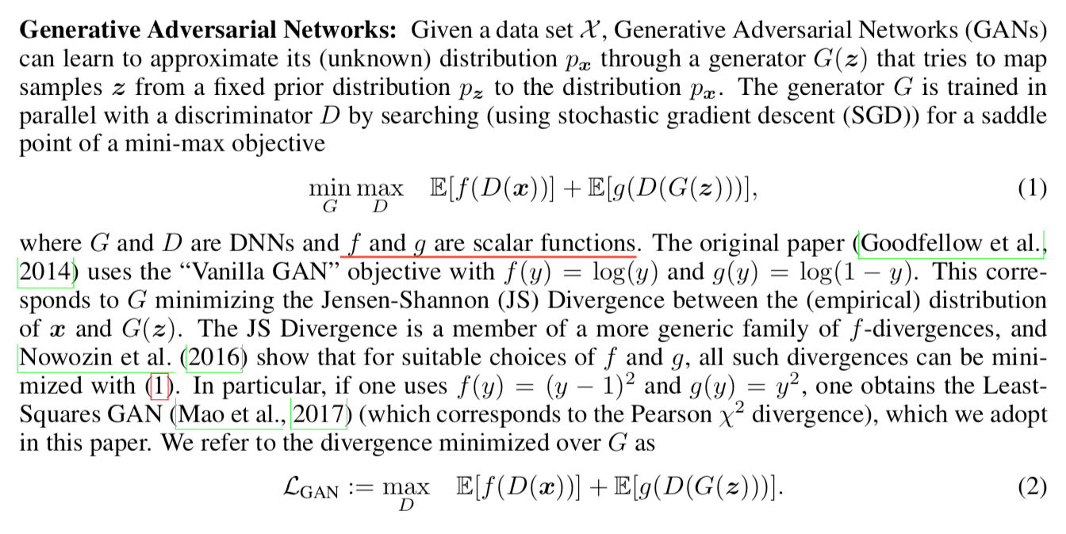

Slide 40
Two types of compression
Generative compression (GC)
preserving the overall image content while generating structure of different scales such as leaves of trees or windows in the facade of buildings, and
selective generative compression (SC)
completely generating parts of the image from a semantic label map while preserving user-defined regions with a high degree of detail.

